Slide 1
Dynamic Graph
Team members:
Akashdeep S (181IT203)
Ashok Bhobhiya (181IT154)
Harshvardhan R (181IT217)
Sujan Reddy (181IT147)

Slide 2
Introduction
Dynamic Graph:
Throughout the Project by Dynamic Graph we define a graph that is subject to a sequence of updates. Edge can be added or deleted and queries are asked such that, weather the graph is connected or not.
Dynamic Connectivity:
Maintain an undirected graph G so that edges may be inserted, deleted and connectivity queries may be answered efficiently.

Slide 3
Contd...
To Maintain Dynamic Connectivity:
We perform these operation on undirected graph
link(u, v): Add in edge {u, v}. The assumption is that u and v are in separate trees.
cut(u, v): Cut the edge {u, v}. The assumption is that the edge exists in the tree.
is_connected(u, v): Return whether u and v are connected.
The Data Structure developed using Euler Tour Tree can perform these operations efficiently. For comparison we did the same using DFS also.

Slide 4
Connectivity with DFS
To compare the developed data structure we do the same thing using DFS.
link(u,v): update the adjacency list.
adList[u].append(v) and adList[v].append(u) for undirected graph
cut(u,v): update the adjacency list.
adList[u].remove(v) and adList[v].remove(u) for the same

Slide 5
Connectivity with DFS Contd...
is_connected(u,v):
First, simply check the adList entry (weather u is directly connected to v).
If not then,
run dfs(u,v)
We run the iterative dfs, start from u and whenever in the middle, if dfs find the v return true otherwise return false.

Slide 6
Euler Tour Trees
In a graph G, an Euler tour is a path through the graph that visits every edge exactly once
For a tree we can consider the undirected edges as 2 directed edges.
● Checking whether two nodes are connected can be done by checking if they're in the same Euler tour

Slide 7
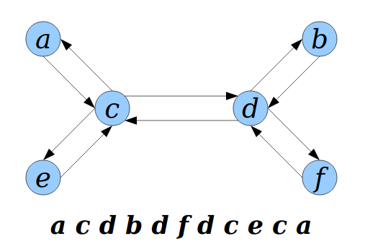

Slide 8
Euler Tour Tree
Algorithm for rerooting :
● Pick any occurrence of the new root r.
● Split the tour into A and B, where B is the part of the tour before r.
● Delete the first node of A and append r.
● Concatenate B and A.

Slide 9
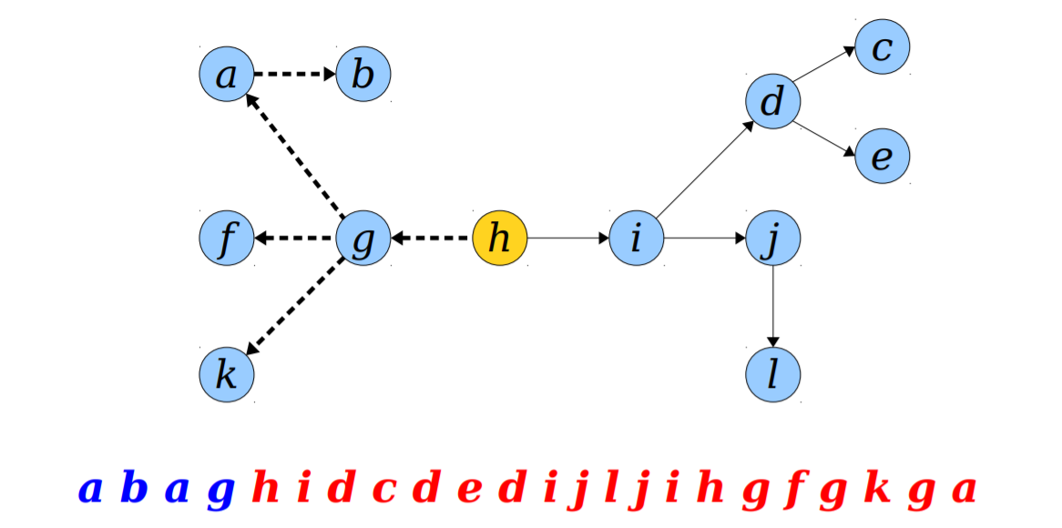

Slide 10
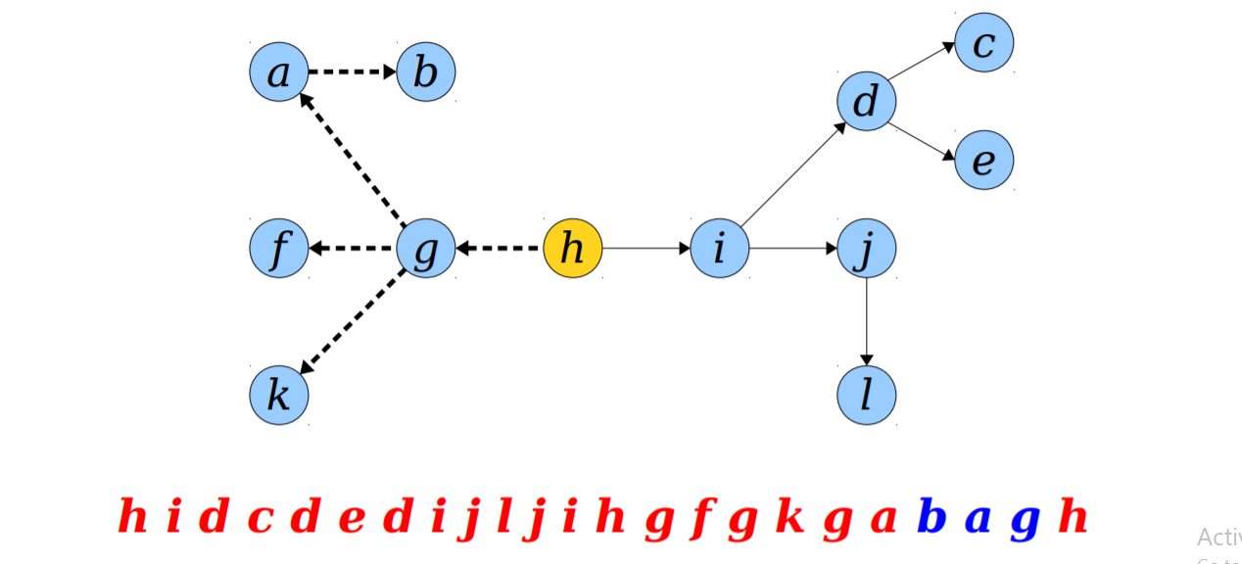

Slide 11
Euler Tour Trees
Given two trees T₁ and T₂, where u ∈ T₁ and v ∈ T₂, executing link(u, v) links the trees together by adding edge {u, v}.
To link T₁ and T₂ by adding {u, v}:
● Let E₁ and E₂ be Euler tours of T₁ and T₂, respectively.
● Rotate E₁ to root the tour at u.
● Rotate E₂ to root the tour at v.
● Concatenate E₁, E₂, {u}.

Slide 12
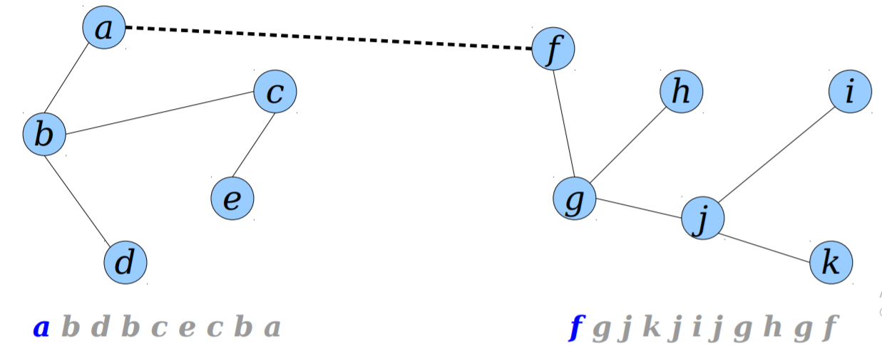
Euler Tour Trees

Slide 13
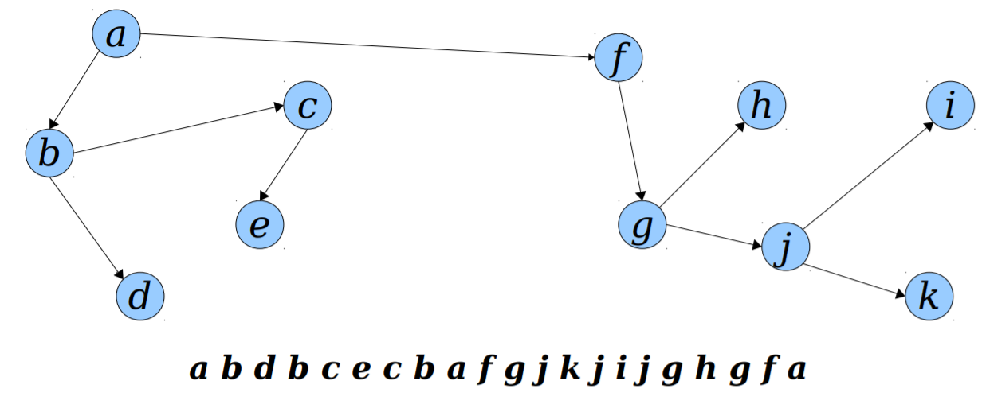
Euler Tour Trees

Slide 14
Euler Tour Trees
Given a tree T, executing cut(u, v) cuts the edge {u, v} from the tree (assuming it exists).
● To cut T into T₁ and T₂ by cutting {u, v}:
● Let E be an Euler tour for T.
● Split E at (u, v) and (v, u) to get J, K, L, in that order.
● Delete the last entry of J.
● Then E₁ = K.
● Then E₂ = J, L

Slide 15
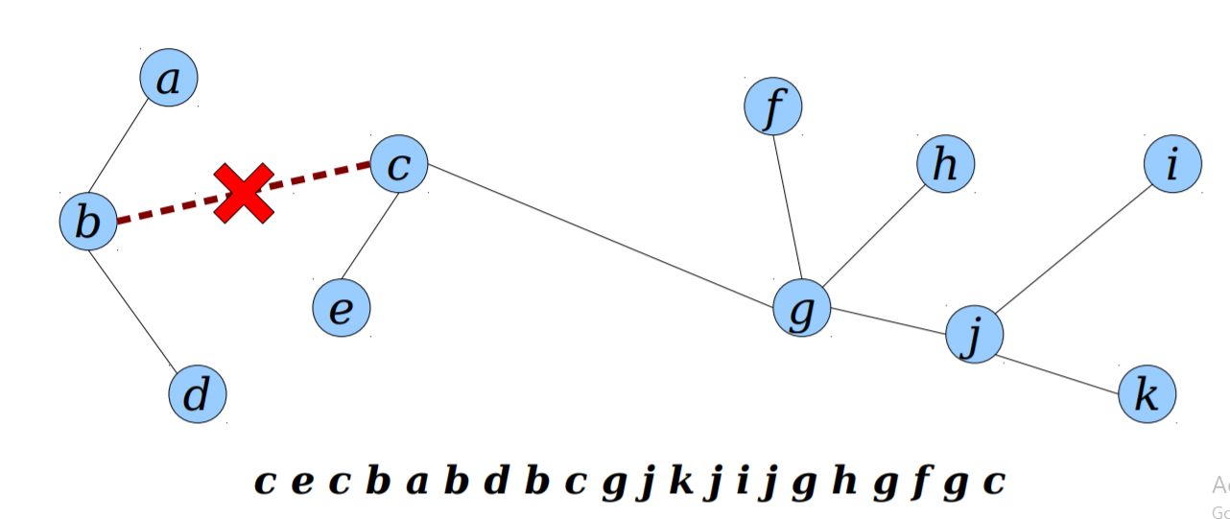
Euler Tour Trees

Slide 16
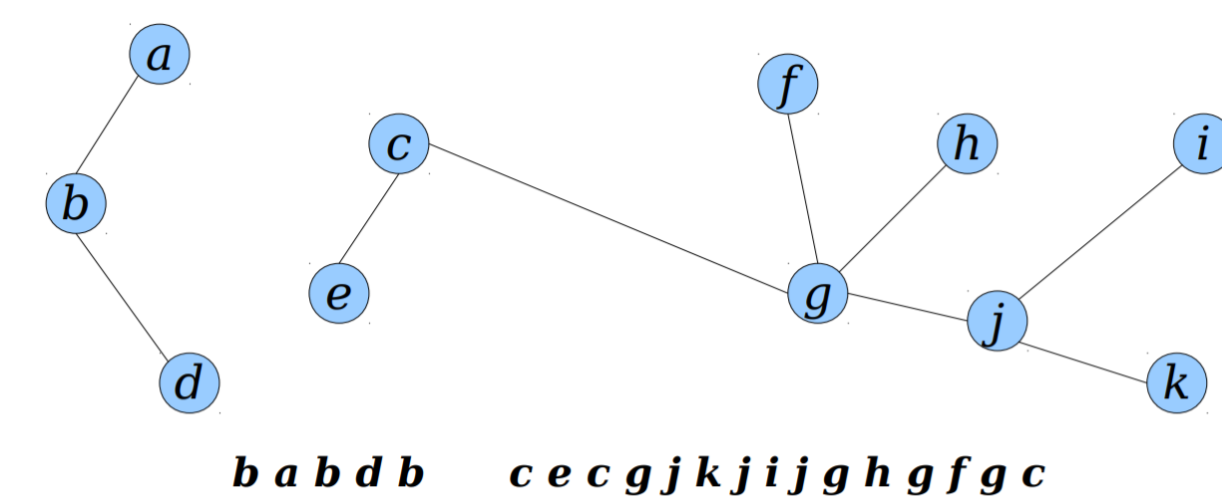
Euler Tour Trees

Slide 17
Connectivity of Graphs
Let G be an undirected graph and let be a F spanning forest for G.
● Observation: Two nodes u and v are connected in G if they are connected in Forest
● Idea: Try to maintain a spanning forest for G, represented as Euler tour trees

Slide 18
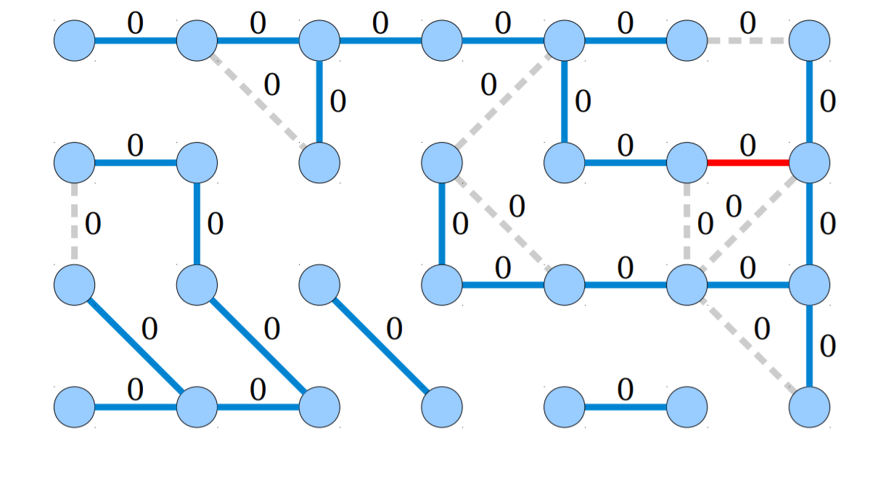

Slide 19
Connectivity of Graphs
To delete a tree edge {u, v} with in level k:
● Let Tu and Tv be the resulting trees.
● Push all the tree edges of specificity k in Tu up to level k + 1.
● For all auxiliary edges incident to u in level k: – If that edge connects Tu to Tv , add it to the forest and stop.– Otherwise, it connects Tu to itself.
● If the previous iteration didn't reconnect Tu and Tv , repeat the above loop on level k – 1.

Slide 21
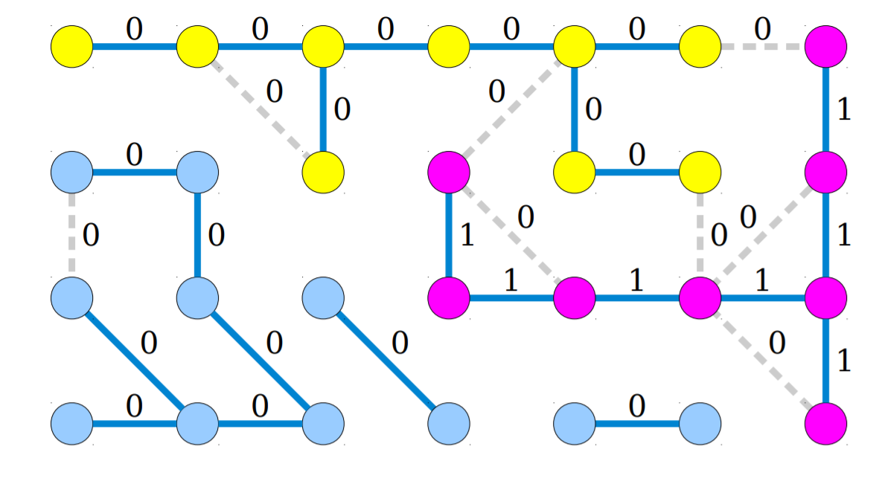

Slide 22
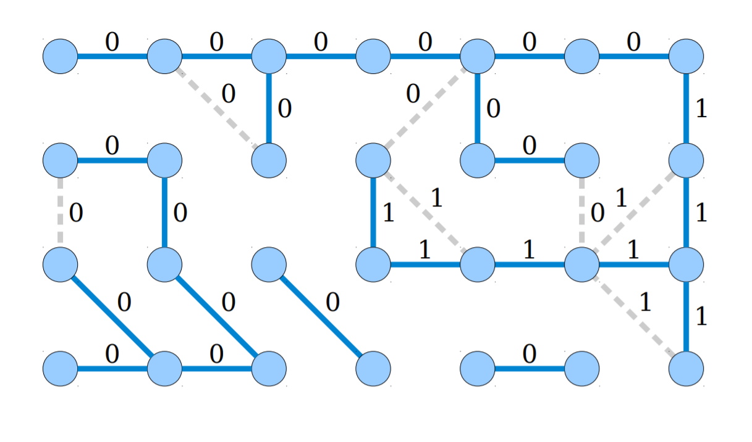

Slide 23
Operation | Complexity
link(u,v) | O(log n)
cut(u,v) | O((log n)^2)
is_connected(u,v) | O(log n)

Slide 24
Experiment
In order to test the correctness and performance of the new data structure , we have compared the data structure with the solution obtained by DFS
The input graph has 100 vertices and 300 edges. The time taken for execution of is_connected(u,v) queries is measured using the python module “time”.
The is_connected(u,v) query is run 10000 times , i.e , between every pair of vertices u,v. with a few random edges deleted

Slide 25
Results
Algorithm | Time Taken
DFS | 1.5 s
Euler-tour-tree Data structure for Graphs | 0.87 s

Slide 26
References
http://web.stanford.edu/class/archive/cs/cs166/cs166.1166/lectures/17/Small17.pdf - A lecture ppt of Stanford .
https://www.youtube.com/watch?v=L7ywsci9ujo&t=1251s - Lecture video from Advanced Data Structures Course in MIT.

